Slide 1
Picturing the Progressive Era
Sylena & Caley

Slide 2
Political Reform
There were many different factors incorporated in political reform.
The Muckrakers were the first to begin the reform, they committed to expose scandals, corruption and injustice to the public.
Unveiling the corruption in politics
The American people benefited more
Citizens were given direct access in terms of voting, for the passage of legislation.
New welfare legislation was enacted
Incapable people received benefits from the government which include food and shelter.
The 17th Amendment
→ The direct election of senators based on the popular vote of the people.
Today: People have the right to vote directly for who they want. The government provides help and aid to those in need. Corruption is no longer a secret, it is exposed and addressed.
http://museumca.org/picturethis/pictures/poster-roosevelt-and-johnson

Slide 3
Women’s Rights
→ “New Women”
Began to change the role and position of women in society
Still oversaw the home but because of the various technologies that were developing, they also began to find things outside of the home in social and business positions
Women received the right to vote out of the women’s suffrage movement.
→ Today: Though many differences still exist in such issues as wages, the rights for women are equal to men. Votes for women opened up the opportunity for women to become equal over time and to their role in society today.
http://24.media.tumblr.com/tumblr_lqd3a2eqgS1qekd4ho1_500.jpg

Slide 4
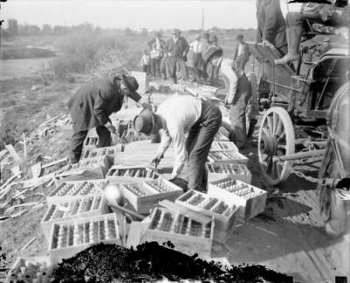
Temperance
The elimination of alcohol was seen as necessary by many progressives, to restore proper order to society.
Scares wages were being spent on alcohol.
Drunkenness was causing more violence and trouble within families.
Employers saw alcohol as a harm to industry efficiency.
The movement was led by women and in 1893, The Anti-Saloon League joined in the action to abolish saloons.
Opposition came from immigrants & working class votes who consumed the most alcohol.
Advocated began to strive for a national prohibition law.
The 18th Amendment
→ Today: Alcohol can still be and is a major problem in society. There have been actions and efforts taken against it to prevent harm and maintain efficiency in certain environments. There are many in favor of alcohol and just as many against it in today’s society.
http://cdm15330.contentdm.oclc.org/cdm/ref/collection/p15330coll22/id/19330

Slide 5
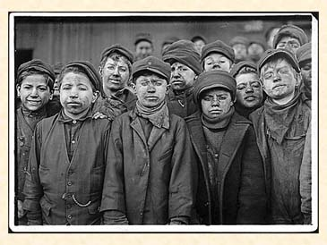
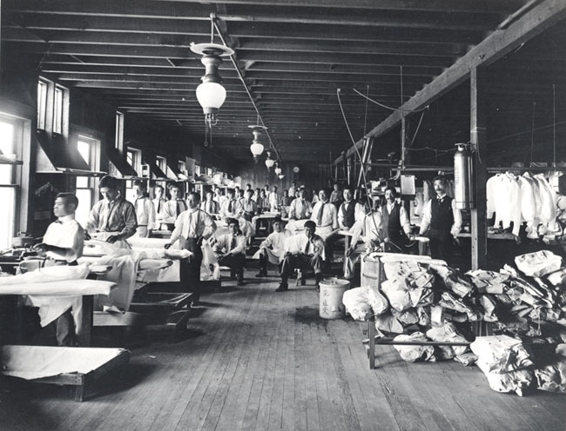
Immigration
During the 1920s, Immigration to the U.S. increased greatly.
Social problems were created with immigration.
Some believed the best way to resolve those problems was to allow the immigrants to integrate and adapt to society.
Many immigrants came from non-English speaking countries, which made it even more difficult for them to adapt.
Eugenices emerged
With the focus on how American society was becoming polluted with racial diversity.
Nativism
Some believed that immigrants should not have come to the U.S.; they are taking advantage of American opportunities that American citizens should have.
Today: There are many immigration laws in place now, especially since the U.S. is such a land of desire and opportunity. Legislation is constantly being passed regarding immigrants and their rights as citizens in this country.
www.maxwell.syr.edu
forum.paradoxplaza.com

Slide 6
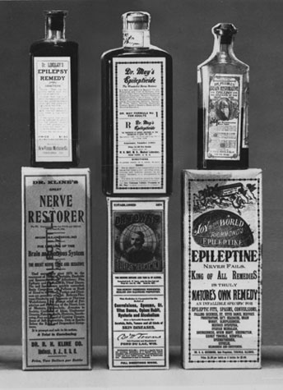
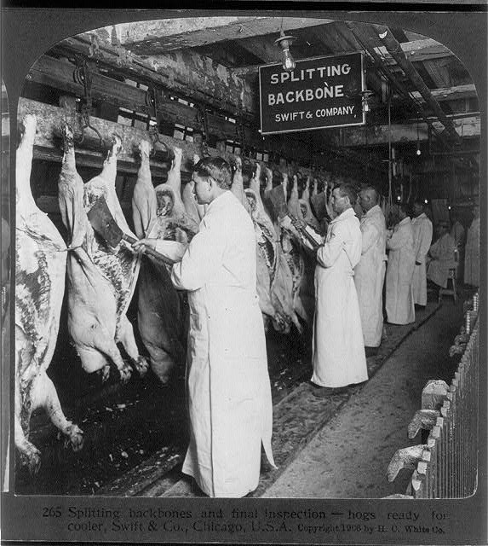
Business Reform
www.fda.gov
One major business reform passed was the Pure Food & Drug act in 1906.
The Federal law required inspection of all meats.
It also forbid the manufacture and sale of products and poisonous medicines.
Specific drugs needed to labeled on products; including alcohol, cocaine, heroin, morphine and cannabis.
The initial movement was to label products properly, but then turned it focus to removing and prohibiting products and medicines that were harmful.
→ Today: The Food & Drug Administration (FDA) continues this procedure today. They monitor all foods and drugs, which first need to be cleared and passed as FDA certified.
en.wikipedia.org

Slide 7
Works Cited
"Immigrants in the Progressive Era - American Memory Timeline- Classroom Presentation | Teacher Resources - Library of Congress." Immigrants in the Progressive Era - American Memory Timeline- Classroom Presentation | Teacher Resources - Library of Congress. N.p., n.d. Web. 09 Mar. 2014. <http://www.loc.gov/teachers/classroommaterials/presentationsandactivities/presentations/timeline/progress/immigrnt/>.
"Progressive Era: 1890â1920s: Progressive Political Reform." Poster of Roosevelt and Johnson. N.p., n.d. Web. 10 Mar. 2014. <http://museumca.org/picturethis/pictures/poster-roosevelt-and-johnson>.
"Progressive Era: 1890â1920s: Progressive Political Reform." Progressive Era: 1890â1920s: Progressive Political Reform. N.p., n.d. Web. 08 Mar. 2014. <http://museumca.org/picturethis/timeline/progressive-era-1890-1920s/progressive-political-reform/info>.
"Prohibition "bust"" :: Western History. N.p., n.d. Web. 10 Mar. 2014. <http://cdm15330.contentdm.oclc.org/cdm/ref/collection/p15330coll22/id/19330>.
"Prohibition in the Progressive Era - American Memory Timeline- Classroom Presentation | Teacher Resources - Library of Congress." Prohibition in the Progressive Era - American Memory Timeline- Classroom Presentation | Teacher Resources - Library of Congress. N.p., n.d. Web. 09 Mar. 2014. <http://www.loc.gov/teachers/classroommaterials/presentationsandactivities/presentations/timeline/progress/prohib/>.
"Pure Food and Drug Act." Princeton University. N.p., n.d. Web. 08 Mar. 2014. <http://www.princeton.edu/~achaney/tmve/wiki100k/docs/Pure_Food_and_Drug_Act.html>.

